Slide 1
Laravel 실무 따라하기
9장. 통계
2022.3 ∼ 2022.10
인덕대학교
컴퓨터소프트웨어학과
교수 윤형태

Slide 2
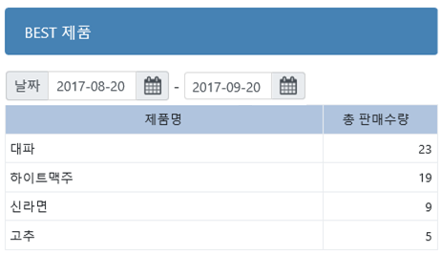
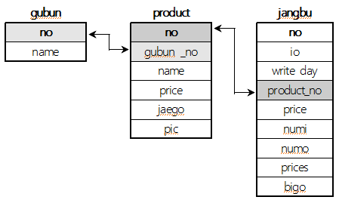
1. BEST제품
기간조회(gigan) 복사하여 작업
Text3 내용은 모두 삭제
총판매수량 → cnumo
매출장(io=1)에서 기간내에 제품별로 판매한 회수를 세어서 가장 많이 판매한 자료 (내림차순)로 정렬

Slide 3
날짜 | 제품 | 수량
2020-01-01 | A | 2
2020-01-01 | B | 3
2020-01-01 | A | 1
2020-01-02 | A | 4
Select count(*) from 장부; → 4
Select sum(수량) from 장부
group by 날짜;
Select sum(수량) from 장부
group by 제품;
날짜 | 제품 | 수량
2020-01-01 | A | 6
2020-01-02 | A | 4
날짜 | 제품 | 수량
2020-01-01 | A | 7
2020-01-01 | B | 3

Slide 4
select products.name as product_name, count(jangbus.numo) as cnumo
from jangbus left join products on jangbus.products_id=products.id
where io=1 and jangbus.writeday between '$text1' and '$text2’
group by products.name
order by cnumo desc;

Slide 5
select products.name as product_name, count(jangbus.numo) as cnumo
from jangbus left join products on jangbus.products_id=products.id
where io=1 and jangbus.writeday between '$text1' and '$text2’
group by products.name
order by cnumo desc;
$result = Jangbu::leftjoin('products','jangbus.products_id','=','products.id')->
select('products.name as product_name', DB::raw('count(jangbus.numo) as cnumo') )->
wherebetween('jangbus.writeday', array($text1,$text2))->
where('jangbus.io','=',1)->
orderby('cnumo','desc')->
groupby('products.name')->
paginate(5)->appends(['text1'=>$text1,'text2'=>$text2]);

Slide 6
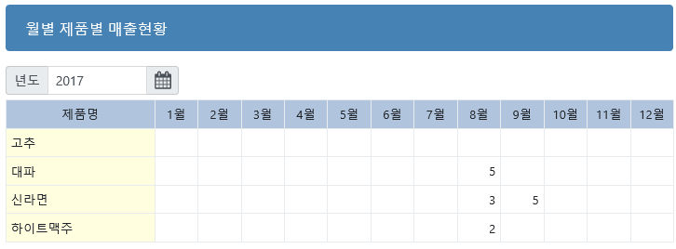
2. 월별 제품별 매출현황
 | 가로축 필드
세 로 축 필 드 | 계산할 필드와 내용 (합계, 평균, 개수, … 등)
Best제품 복사하여 작업 → crosstab

Slide 7
제품별
매출합계 :
select products.name as product_name,
sum( jangbus.numo ) as s
from jangbus left join products on jangbus.product_id=products.id
where year(jangbus.writeday)=$text1
group by jangbus.products_id
order by products.name;
제품별 월별
매출합계 :
select products.name as product_name,
sum( if(month(jangbus.writeday)=1, jangbus.numo, 0) ) as s1,
sum( if(month(jangbus.writeday)=2, jangbus.numo, 0) ) as s2,
… … …
sum( if(month(jangbus.writeday)=12, jangbus.numo, 0) ) as s12,
from jangbus left join products on jangbus.product_id=products.id
… … …

Slide 8
$result = Jangbu::leftjoin('products','jangbus.products_id','=','products.id')->
select( 'products.name as product_name',
DB::raw('sum( if(month(jangbus.writeday)=1, jangbus.numo,0) ) as s1,
sum( if(month(jangbus.writeday)=2, jangbus.numo,0) ) as s2,
… … …
sum( if(month(jangbus.writeday)=12, jangbus.numo,0) ) as s12 ') )->
where(DB::raw('year(jangbus.writeday)'), '=', $text1)->
where('jangbus.io', '=', 1)->
orderby('products.name')->
groupby('products.name')->
paginate(5)->appends( $text1 );

Slide 9
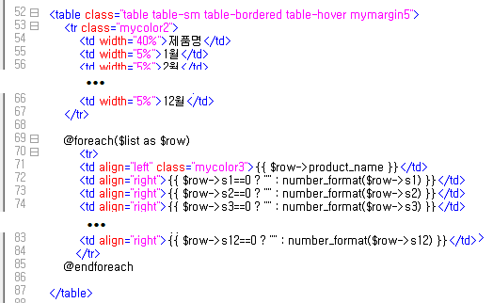

Slide 10
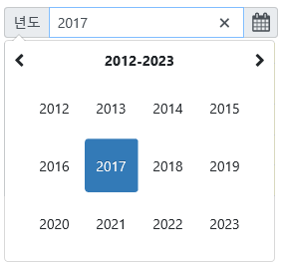
달력컨트롤 수정
$text1 = $request->input("text1")
if (!$text1) $text1=date("Y");
$("#text1") .datetimepicker({
locale: "ko",
format: "YYYY",
viewMode: "years",
defaultDate: moment()
});

Slide 11
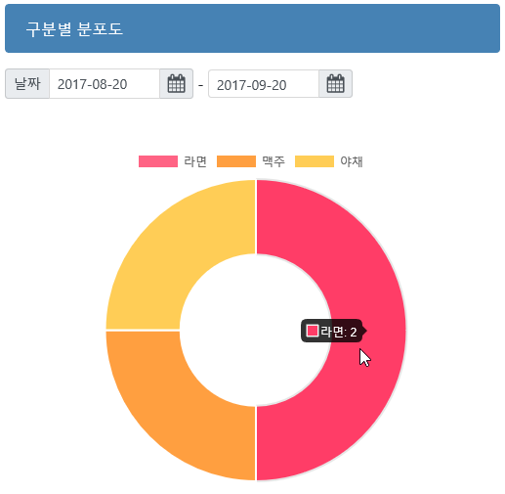
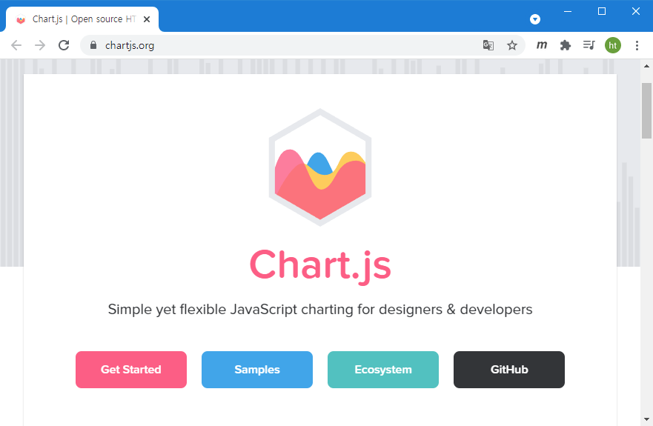
3. 구분별 분포도
Best제품 복사하여 작업 → graph (page관련내용삭제)
Chart.js 설치

Slide 12

select gubuns.name as gubun_name, count(jangbus.numo) as cnumo
from (gubuns right join products on gubuns.id=products.gubuns_id)
right join jangbus on products.id=jangbus.product_id
where io=1 and jangbus.writeday between '$text1' and '$text2’
group by gubuns.name
order by cnumo desc limit 14
 | gubuns |  | products |  | jangbus
 | id |  | id |  | id
 | name |  | gubuns_id |  | io
 |  |  | name |  | writeday
 |  |  | price |  | products_id
 |  |  | jaego |  | price
 |  |  | pic |  | numi
 |  |  |  |  | numo
 |  |  |  |  | prices
 |  |  |  |  | bigo

Slide 13
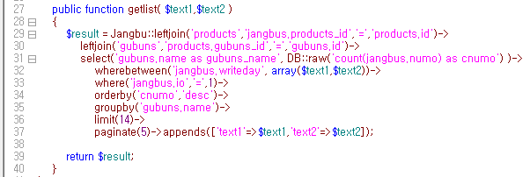

Slide 14
<script> const ctx = document.getElementById('myChart'); " const myChart = new Chart(ctx, { type: '그래프종류'', data: { labels: [ '라벨1', '라벨2', … ], datasets: [{ data: [ 값1, 값2, … ], backgroundColor: [ '색1', '색2', … ], }], }, }); </script> | // 종류: doughnut // 범례: 구분이름 // 값: 매출건수 // 각 영역 배경색

Slide 15
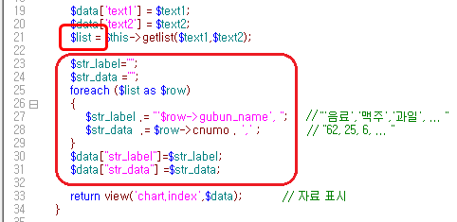

Slide 16
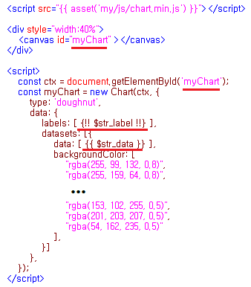
→"'음료', '맥주', '과일', ... “
→ 62, 5, 20

Slide 17
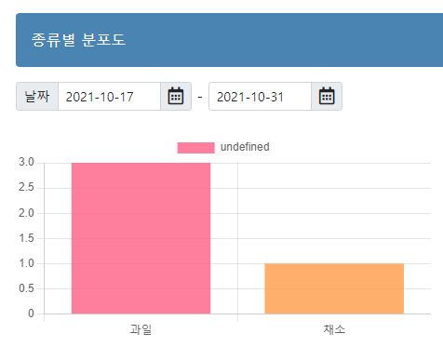
type : doughnut → bar, line …

